Slide 1
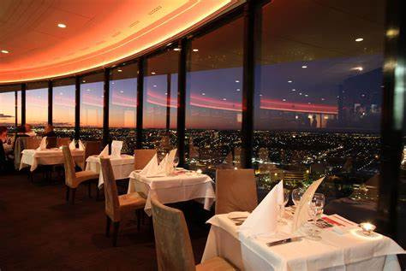


RESTAURANT BILLING MANAGEMENT SYSTEM
Streamlining Restaurant Billing with a modern management system
PRESENTED BY
Mohammed Abdullah Khan

Slide 2

3 | Background of the Study
4 | Problem Statement
5 | Features and Implementation
6 | Analysis
AGENDA

Slide 3
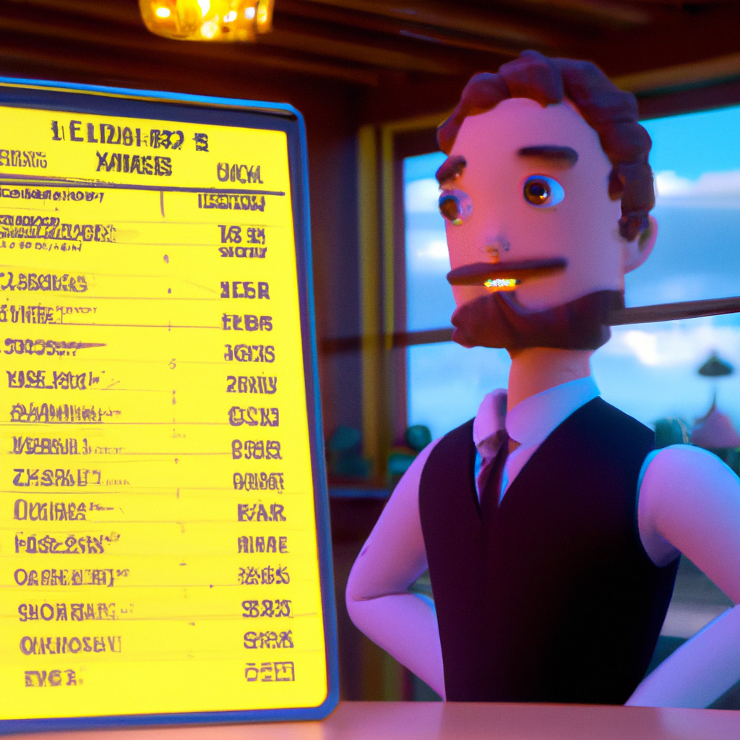
BACKGROUND
OF THE STUDY
A restaurant billing management system is a software solution designed to help restaurant owners manage their billing processes. It automates and streamlines the restaurant's billing process, allowing the restaurant to track orders, manage customer information, and process payments.
Back to Agenda
03

Slide 4
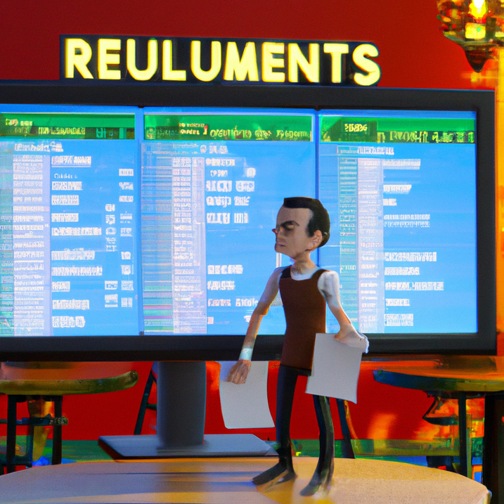
PROBLEM STATEMENT
Scope of the study | To automate the Billing system in Restaurants
Relevance of the study | The data stored gives clear analysis of the overall Business and various steps could be taken by storing the most sold dish of a particular day
Back to Agenda
04

Slide 5
FEATURES & IMPLEMENTATION
FEATURES | IMPLEMENTATION
Add items to cart once and keep changing the quantity Generate Invoice and display the total amount | If the item is added doesn't exists then it gets added to the cart else quantity will get incremented A random 7 digit string is generated and allocated to the order id
Back to Agenda
05

Slide 6
ANALYSIS
Based on the data stored business analysis could be performed
125
100
75
50
25
0
Dish 1
Dish 2
Dish 3
Dish 4
Dish 5
Back to Agenda
06

